Slide 1
STRATEGIC ASSET ALLOCATION & MODERN PORTFOLIO PROPORSAL
EVERGREEN FOUNDATION ENDOWNMENT
Presented by:
Venkata Sai Prasad Kancharana
Ms in Quantitative Risk Analysis & Management

Slide 2
Client Objectives & IPS framework
Risk tolerance and policy constraints
Capital market assumptions & methodology
Model portfolios: Conservative, Moderate, Growth
Efficient frontier & opportunity set
Risk, diversification & compliance review
Key observations & recommendation
AGENDA

Slide 3

Client Overview & Investment Objective
Client Profile • Evergreen Foundation Endowment (~$1.0B) • Perpetual investment horizon • Mission-driven capital with intergenerational equity
Primary Investment Objective • Preserve and grow real (inflation-adjusted) purchasing power • Support stable annual spending for Foundation programs
Return Objective • Target nominal return: CPI + 4.0% (net of fees)

Slide 4

Spending Policy & Liquidity Needs
Spending Policy • Annual distribution: 4.0% of a 3-year trailing average market value • Board discretion to smooth distributions during stressed periods
Liquidity Requirements • Maintain sufficient liquid assets to fund 6–9 months of distributions • Target cash & liquidity allocation: ~4–6% • Minimum allowable cash: 3%

Slide 5

Risk Tolerance & Governance Constraints
Risk Profile • Moderate risk tolerance • Willing to accept interim volatility to achieve long-term real returns
Risk Limits • Target long-term volatility: ~10%–16% • No portfolio-level leverage without approval
Governance Emphasis • Diversification, transparency, and policy discipline

Slide 6
Policy Asset Allocation (Targets & Ranges)
Policy Allocation Framework
ASSET CLASS | TARGET | RANGE
Global Equity | 40% | 30-55%
Private Equity | 12% | 8-20%
Real Assets | 12% | 6-18%
Hedge Funds | 8% | 0-15%
Credit | 10% | 5-15%
Core Fixed Income | 12% | 5-25%
Cash | 6% | 3-10%

Slide 7

Capital Market Assumptions (Inputs)
Key Inputs Used in Portfolio Construction • Long-term expected returns by asset class • Annualized covariance and correlation matrix • Conservative, policy-consistent assumptions
Philosophy • Emphasis on long-term behavior rather than short-term forecasts • Diversification benefits explicitly incorporated

Slide 8
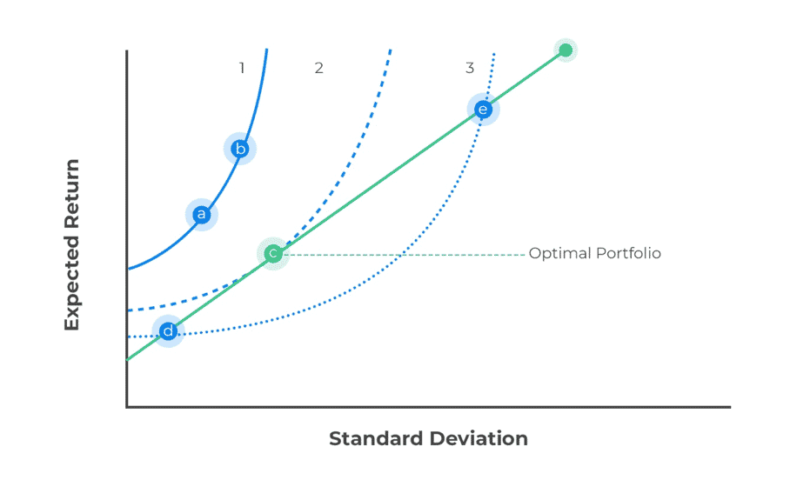
Portfolio Construction Methodology
Approach • Mean-Variance Optimization (MVO) framework • Objective: maximize risk-adjusted return
Key Constraints Applied • Full investment (weights sum to 100%) • No short selling • Asset class ranges per IPS • Illiquid assets ≤ 25% • Cash ≥ 3%

Slide 9
Building Different Portfolios with Various Ranges
ASSET CLASS | CONSERVATIVE RANGE | MODERATE RANGE | GROWTH RANGE
Global Equity | 20-35% | 35-50% | 45-55%
Private Equity | 0-10% | 8-15% | 12-20%
Real Assets | 5-12% | 8-15% | 10-18%
Hedge Funds | 0-10% | 5-12% | 5-15%
Credit | 10-20% | 8-15% | 5-12%
Core Fixed Income | 20-35% | 10-20% | 5-12%
Cash | 5-10% | 3-7% | 3-5%
Rationale for Three Model Portfolios • Conservative: Capital preservation focus • Moderate: Balanced risk-return profile • Growth: Long-term return maximization

Slide 10
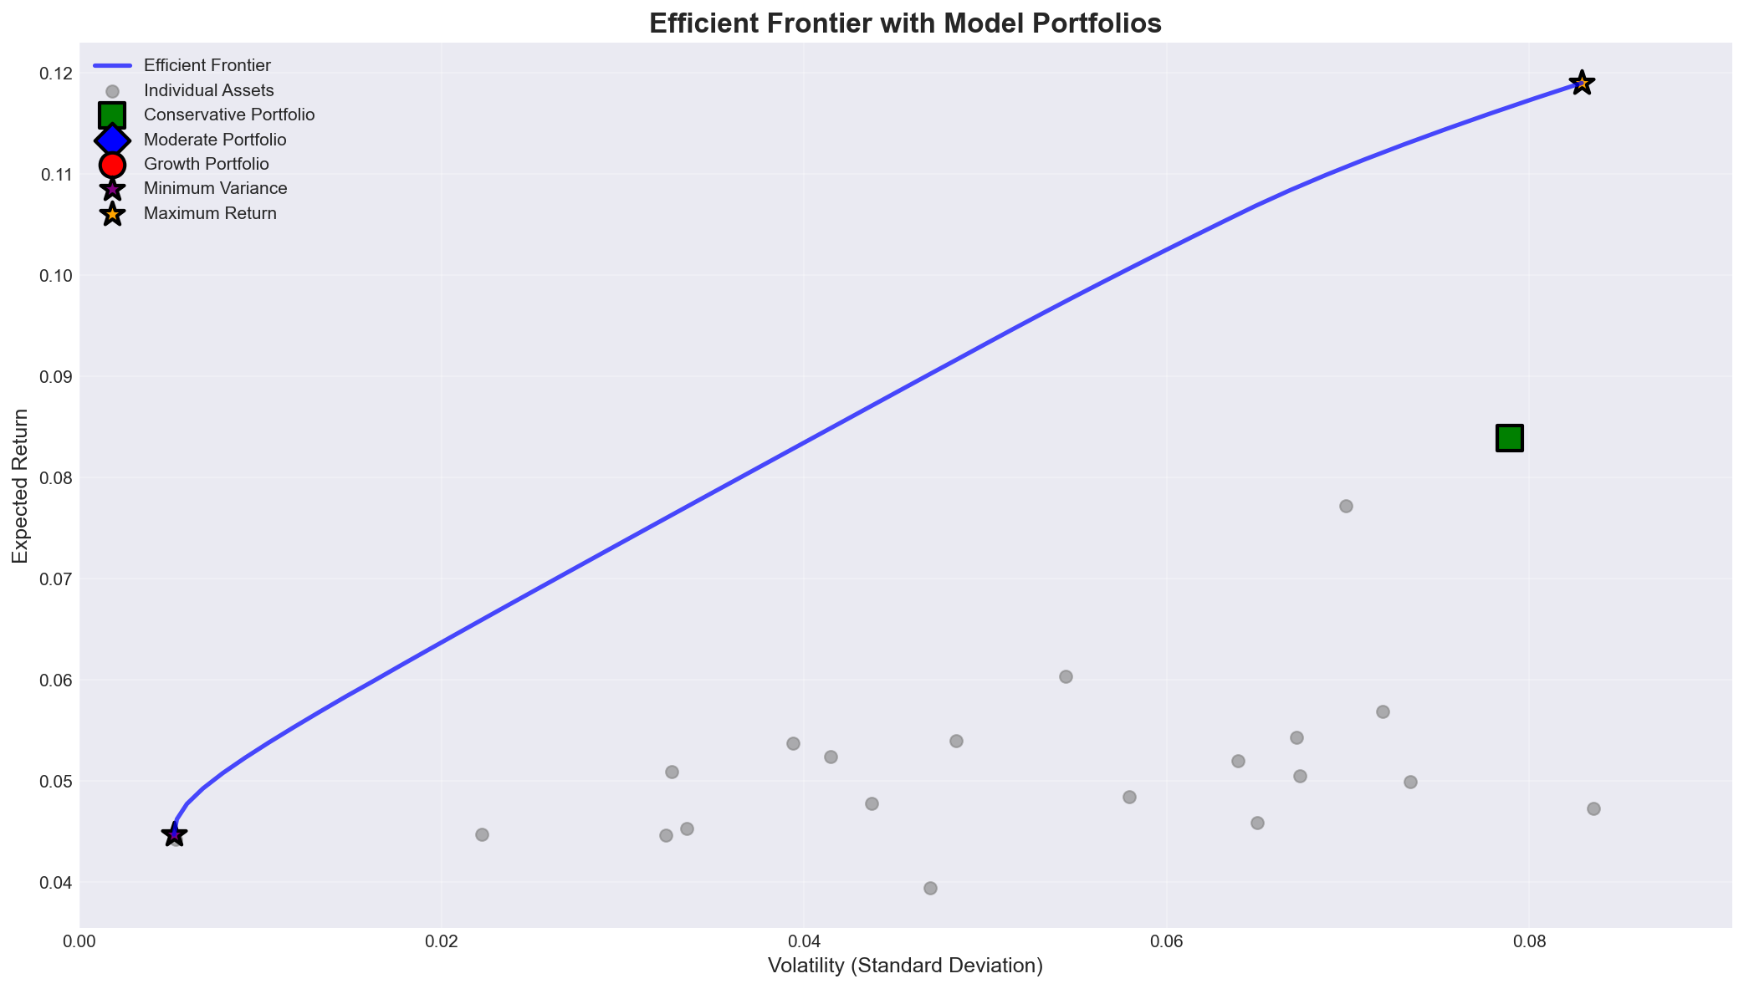
Efficient Frontier (Feasible Opportunity Set)
• Frontier reflects only IPS-compliant portfolios • Demonstrates trade-off between risk and expected return • Model portfolios lie on or near the efficient frontier

Slide 11
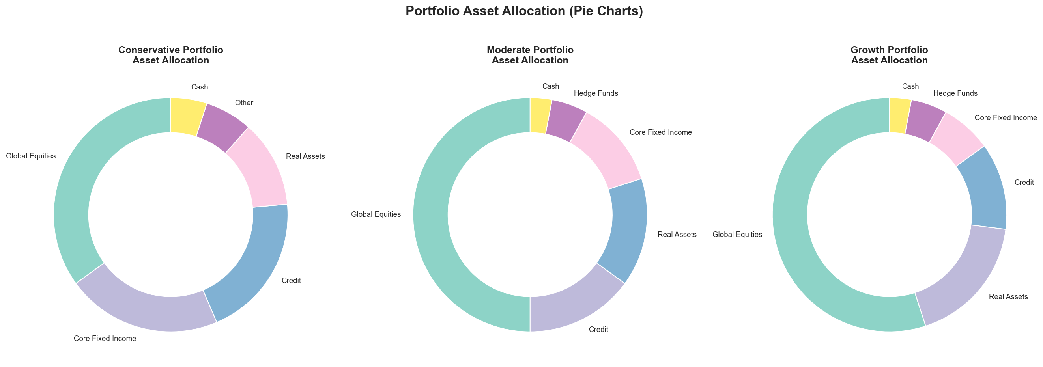
Asset Allocation by Category
• Clear differentiation across portfolios • Increasing equity and illiquidity from Conservative → Growth • All allocations remain within IPS ranges

Slide 12
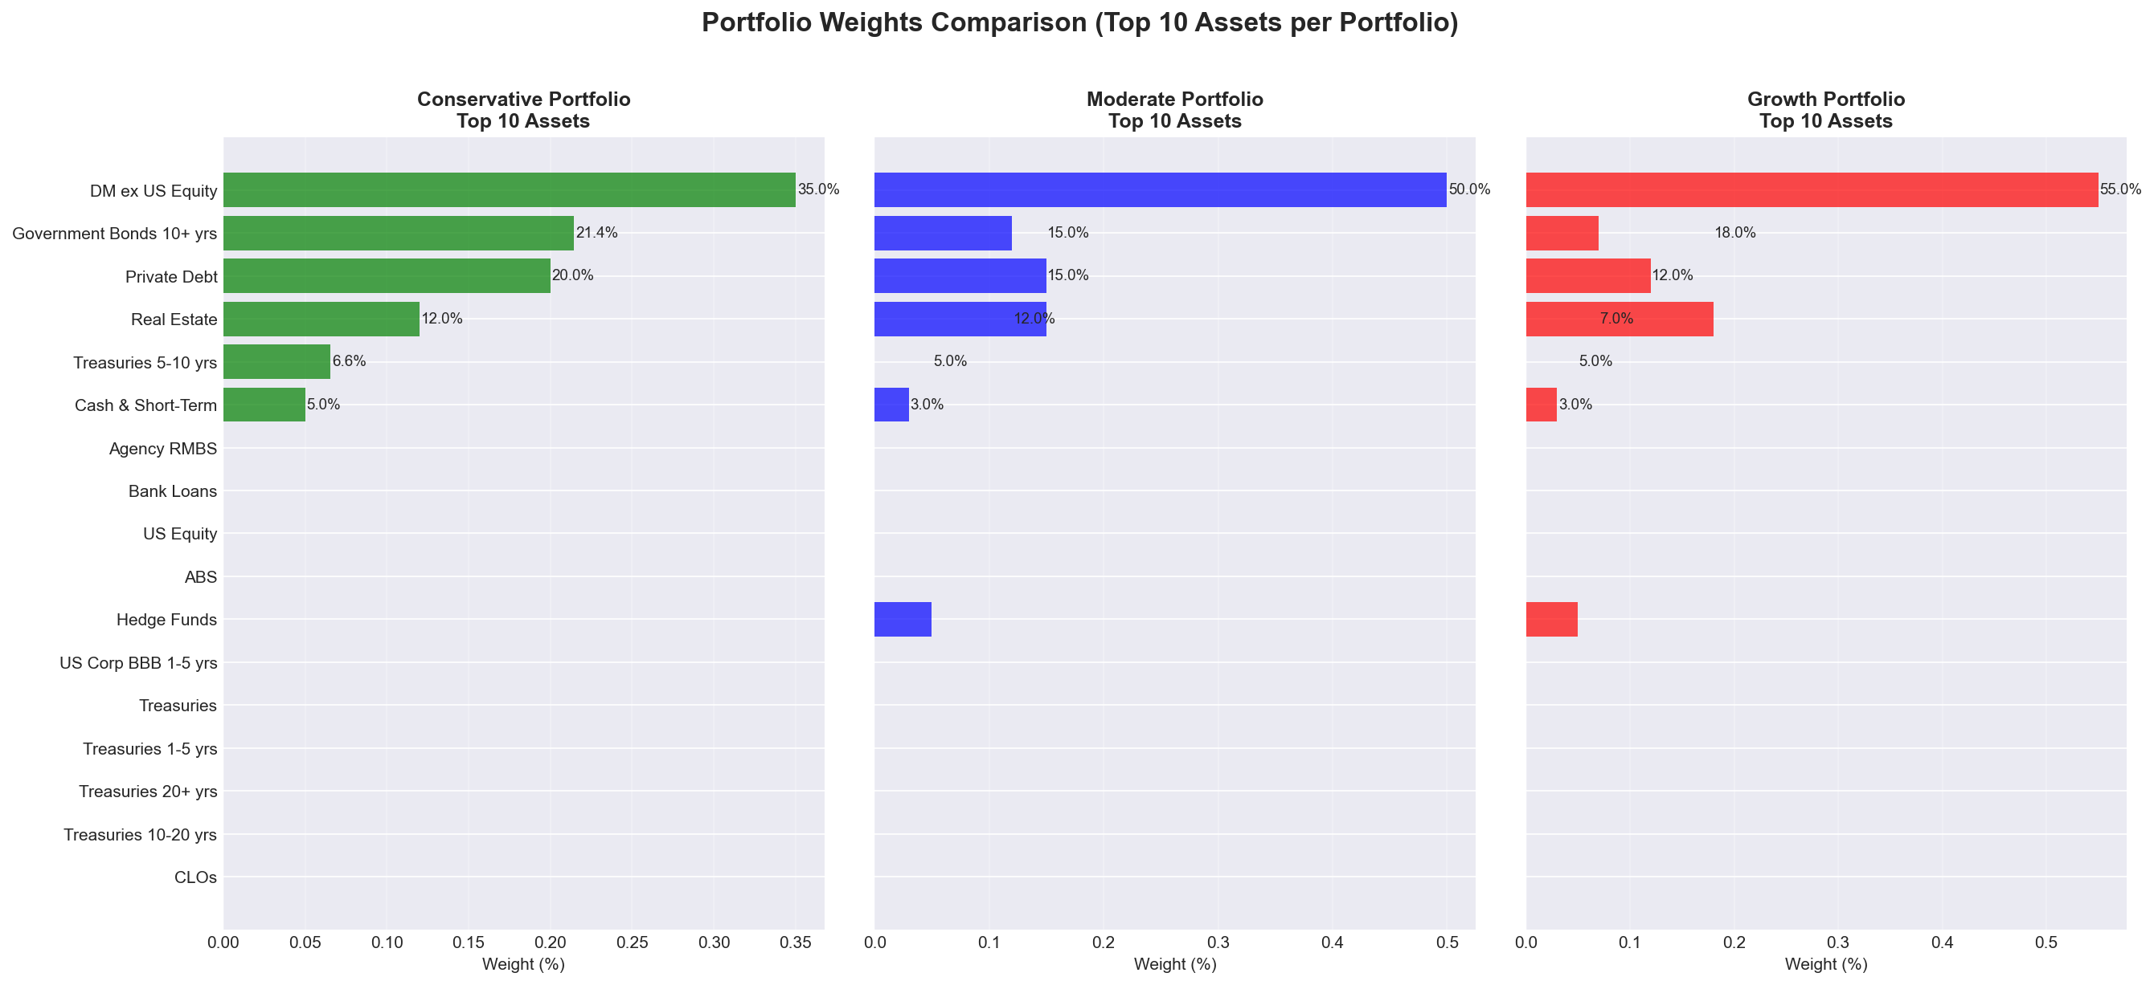
Portfolio Composition: Top Holdings
• Broad diversification across assets • No excessive concentration in single assets • Implementation-ready structure

Slide 13
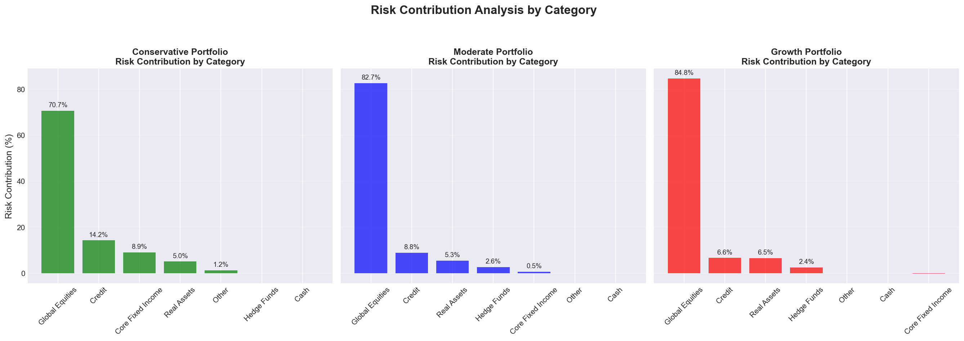
Risk Contribution Analysis
• Risk contribution differs materially from capital allocation • Equity assets dominate total portfolio risk • Defensive assets provide volatility dampening

Slide 14
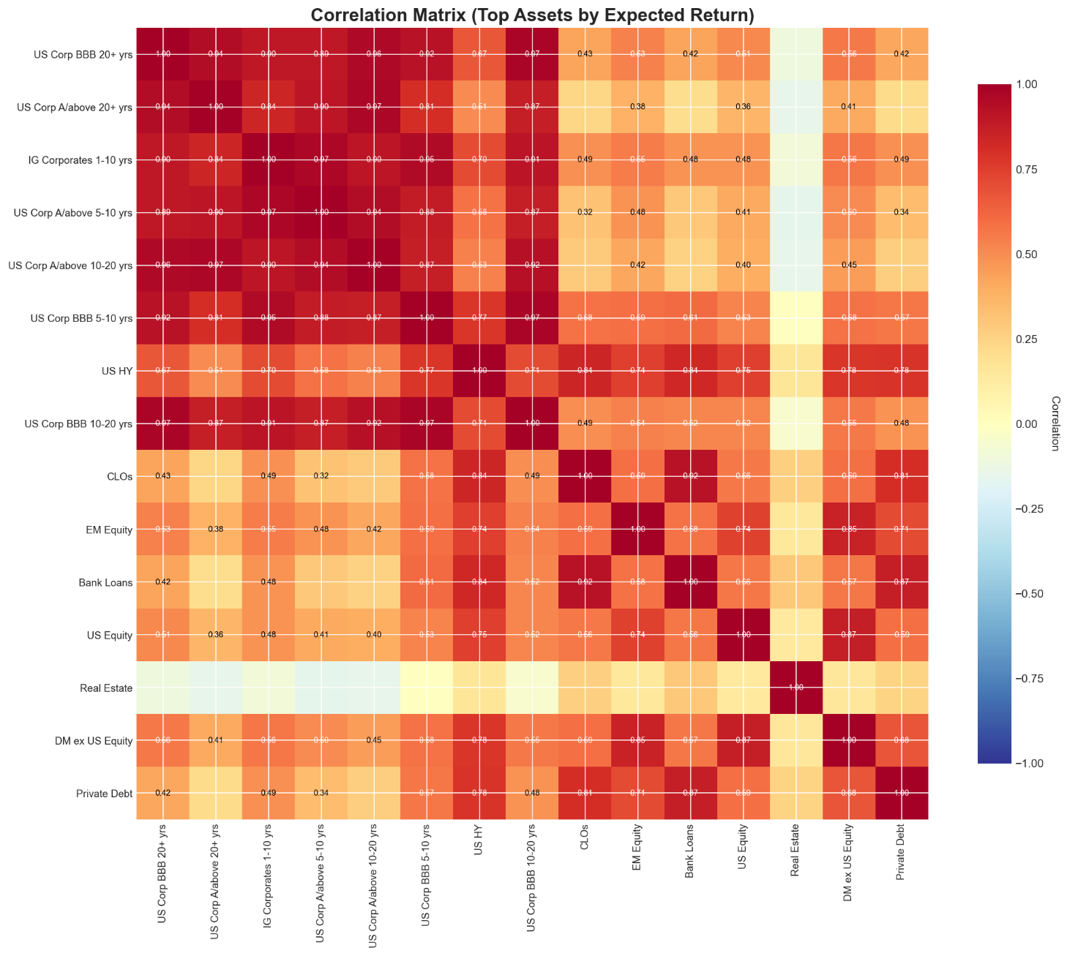
Correlation & Diversification Benefits
Key Takeaways
• Low to moderate correlations across asset classes • Alternatives and real assets enhance diversification • Improved downside risk resilience

Slide 15
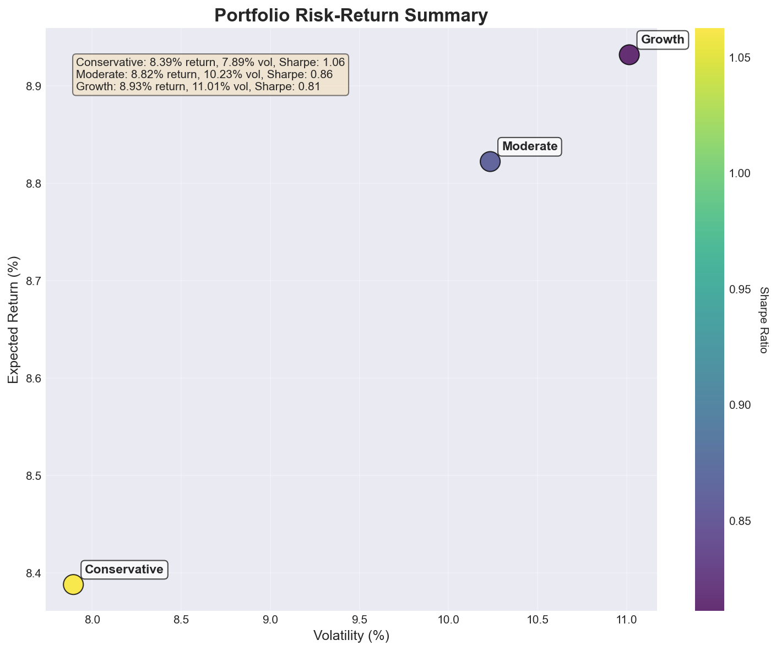
Risk–Return Profile Summary
Comparison • Conservative: Lower return, lower volatility • Moderate: Balanced return and risk • Growth: Higher expected return with higher volatility
• All portfolios fall within IPS volatility target range

Slide 16

Constraint Compliance & Trade-offs
Summary • All asset class allocations within policy ranges • Illiquid exposure remains below stated limits • Cash minimum satisfied • Volatility aligned with target band
Key Observations
• Higher illiquidity improves expected return but raises risk • Diversification meaningfully reduces portfolio volatility • Moderate portfolio aligns most closely with IPS targets • Growth portfolio maximizes long-term purchasing power

Slide 17

Conclusion & Next Steps
Conclusion • IPS-aligned, governance-driven portfolios constructed • Clear risk-return trade-offs presented • Strong diversification achieved
Next Steps • Stress testing and scenario analysis • Monte Carlo analysis of purchasing power • Manager selection and implementation planning

Slide 18
Thank You

